Slide 1
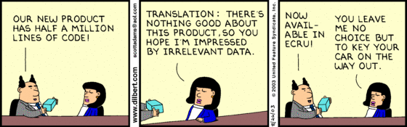
Scripting I
Notes:
image: http://dilbert.com/fast/2003-08-26

Slide 2
Introduction
Scripting Overview
Shell Scripting
Python Scripting
Perl Scripting

Slide 3
Scripting Overview

Slide 4
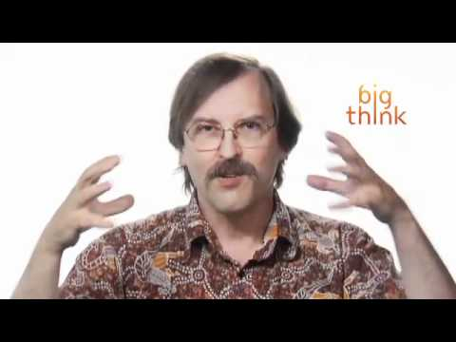
Why Hobbits Make Good Script Writers!
Larry Wall is the guy who created Perl.
Notes:
Start video at around 1:30

Slide 5
Scripting Overview
Method of batch-executing a series of commands
usually a task that's done on a regular basis and requires automation
Typically interpreted at execution
compile and link are not required to execute
some scripts are actually compiled for speed
Many environments
Linux; Windows; switches; routers
Notes:
In Windows the main scripting language calls its executables, 'batch' files.

Slide 6

Scripting Overview
Unix/Linux Scripting
Hash-Bang
aka "shebang"
When executed
reads shebang line
runs the interpreter specified
uses script as first argument
You can add arguments to interpreter line
`#!/bin/bash -l`
`#!/usr/bin/python -o`
Notes:
Not exactly portable. POSIX doesn't specify install locations, so an interpreter may be in /usr/bin/ on one distro, but in /bin/ in another. One way around this is to use `#!/usr/bin/env interpreter` instead. However, this also presents problems in that additional arguments are not passed properly to the `env` app.
image: http://en.wikipedia.org/wiki/Shebang_(Unix)

Slide 7
Scripting Overview
Languages
Shell Scripting
Bourne Shell; Bash
C-Shell; TCSH
Interpreted Languages
Python
Perl
Ruby
PHP

Slide 8
Shell Scripting
Each shell (i.e. Bash; TCSH)
allows batch processing of commands from a single file
allows for flow-control through statements
if-statements / while-loops / for-loops / functions
has its own syntax

Slide 9
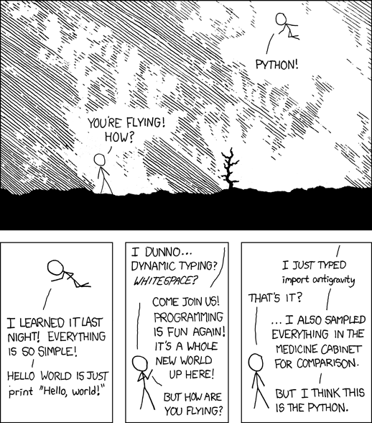
Python Scripting
Notes:
image: http://imgs.xkcd.com/comics/python.png

Slide 10
Python Scripting
Highly readable code
easy to maintain
faster to write than C/C++/Java
whitespace dependent
Big features
object oriented
error handling
memory management
Many modules for extensibility
Integrated with many apps and environments
Good 'in-between' language

Slide 11
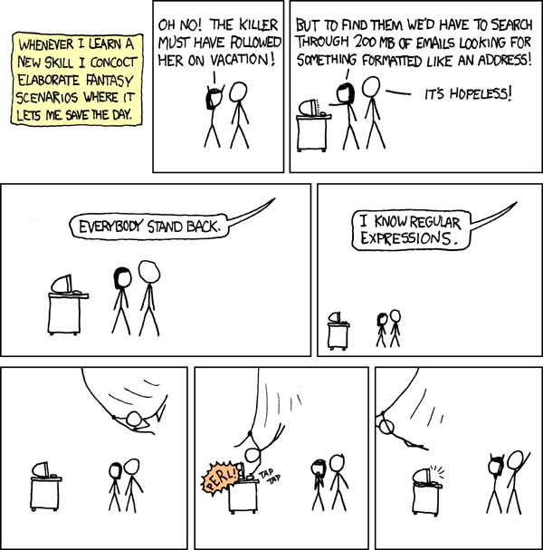
Perl Scripting
Notes:
image: http://imgs.xkcd.com/comics/regular_expressions.png

Slide 12
Perl Scripting
Great for
text processing
database interfacing
Can be hard to read
some can make it a 'write-only' language
can create ascii art
Older language
but still useful!
was called the "duct tape of the Internet"
Lots of libraries and extensions
Notes:
http://en.wikipedia.org/wiki/Just_another_Perl_hacker
http://mysite.verizon.net/les.peters/id2.html

Slide 13
Summary

Slide 14
Summary
Overview
Shell Scripting
Python Scripting
Perl Scripting

Slide 15
Questions

Slide 16
Quiz
What language would be good for creating a prototype that performs math calculations?
What language would be a good choice for creating an installation script?
What language would be a good choice for parsing through log files to find security breaches automatically?
Notes:
While all of the languages discussed can do all of these tasks, there are some that are a better choice than others for various reasons. And in reality, the correct answer is “which one do you already know (or want to learn)?”
Python; can be compiled for speed, has multiple math libraries, and easy multithreading, can be directly interfaced later with C/C++ using SWIG
Bash (or other variants, like TCSH); due to ease of command execution
Perl; best API for pattern matching, though Python comes in a close second

